Slide 1
Chemistry – Sept 24, 2019
P3 Challenge –
Classify an apple according to
1) solid/liquid/gas
2) pure substance/mixture
3) element/compound/homogeneous/heterogeneous
When done with P3, study for Element practice quiz. We will do that first.

Slide 2
Objectives and Agenda
Objectives
To identify physical and chemical properties
To identify physical and chemical changes
To learn about ways to separate mixtures
Assignment: Physical and chemical properties and changes worksheet
Agenda:
Element quiz
Complete Matter Classification
Physical properties
Chemical properties
Physical changes
Chemical changes
Separation methods

Slide 3
Classification of Matter
Besides identifying the state of matter (solid, liquid, gas) we can also classify matter according to its composition
Distinctions to make
Mixtures – Pure substances
Homogeneous – Heterogeneous
Elements – Compounds

Slide 4
Types of Pure Substances
Mixtures separated by physical means into components are pure substances.
Decompose pure substances using chemical methods: reactivity with other substances, reaction to heat, light or electricity
Element = Pure substance that cannot be broken down into simpler pure substances by any chemical means
Compound = Pure substance that can be broken down into simpler pure substances (other compounds or elements) by chemical means.

Slide 5
Elements
Practice quiz for all 51 Memory elements on 9/24
10 pt quiz for 30 random elements on 9/26
118 known, 91 naturally occurring, 27 synthetic elements
Each element given a one or two letter symbol based on their name in English or Latin (first is capitalized)
Organized on the periodic table
Memorize the symbols for elements with Z ≤ 36 and a few others that are common: Zr, Ag, Sn, Sb, I, Xe, Ba, W, Pt, Au, Hg, Pb, Rn, U, Pu
Remember, the symbol applies to both a single atom and a macroscopic sample of the element

Slide 6
Compounds
Compounds are either crystalline or amorphous (salt/molecule, inorganic/organic)
Law of constant composition / definite proportions
All samples of a given compound contain exactly the same proportion of elements by mass.
Organic Compounds far outnumber Inorganic Compounds even though they only involve a relatively few kinds of elements
Organic compounds typically contain C, H, O, and/or N

Slide 7
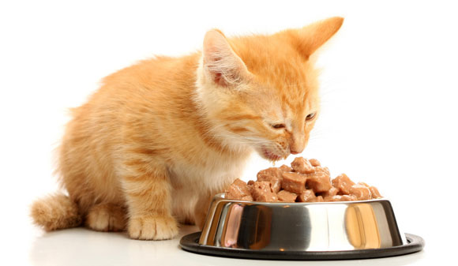
Properties of Matter
Properties distinguish one pure substance from another
Physical Properties = characteristics of a substance that do not change its identity
State (solid, liquid, gas)
Melting point, boiling point
Color, odor, taste, hardness, viscosity, electromagnetic behavior
Density, mass, volume

Slide 8
Properties of Matter
Chemical Properties = characteristics of a substance that describe how its identity changes
Reactivity with other substances
Ex: Reactions with air or water, flammability, toxicity
Stability under certain conditions
Ex: Radioactivity, thermal stability

Slide 9
Properties of Matter
Extensive properties depend on how much of the substance is present.
Ex: mass, moles, volume, length, toxicity
Intensive properties are the same regardless of how much of the substance is present.
Ex: state, density, boiling point, melting point, molar mass, temperature, hardness, color, odor, taste, heat capacity, elasticity, conductivity, radioactivity, flammability

Slide 10
Changes in Matter
Physical Change = a process that changes a substance’s physical properties but not its chemical identity
change of state
forming or separating mixtures
Chemical Change = a process that changes a substance’s chemical identity
chemical reaction reactants → products
Only an examination of the substances before and after a change can verify whether the change is physical or chemical.

Slide 11
Changes of State
Melting point (m.p.) or freezing point
temperature at which a substance changes from solid to liquid
Boiling point (b.p) or condensation point
temperature at which a substance changes from liquid to gas

Slide 12
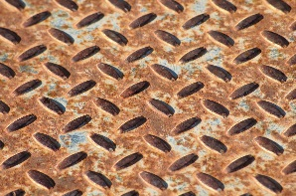
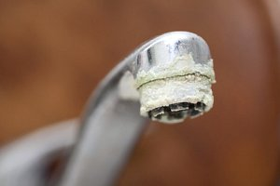
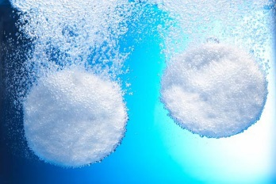
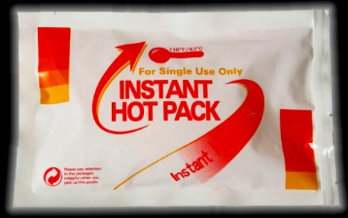
Evidence of a possible chemical reaction/change
Color change (ex: rust formation)
Formation of a solid (ex: hard water deposits)
Formation of a gas (ex: Alka Seltzer)
Emission of light (ex: fireworks)
Spontaneous exchange of heat (heats up or cools down) (ex: hot/cold packs)
These five observations usually indicate a chemical change
Note: Phase changes may also involve the formation of a solid or a gas,
Physical state changes due to heat addition/subtraction
Chemical state changes due to mixing different substances

Slide 13
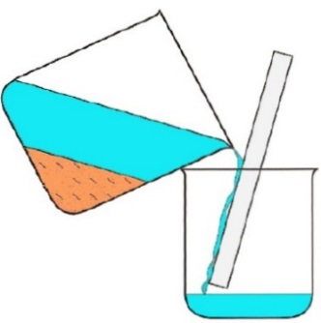
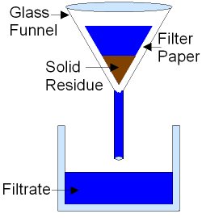
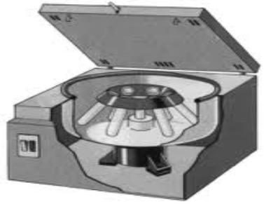
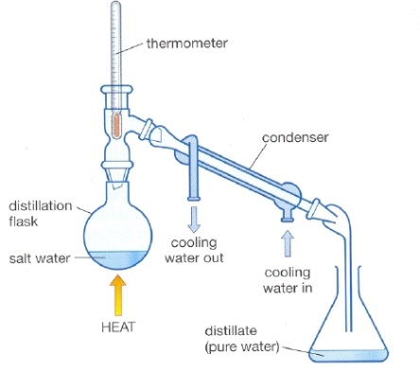
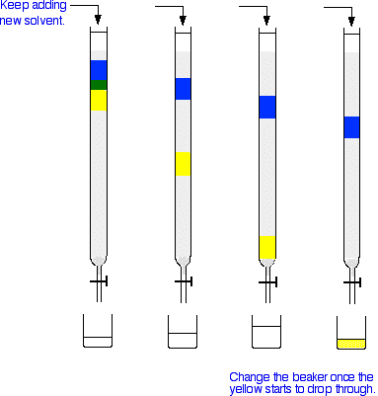
Mechanical Means of Separation
Decantation (separates a solid from a liquid or two liquids based on density)
Filtration (separates a solid from a liquid based on particle size)
Centrifugation (separates a solid from a liquid or two liquids based on density)
Distillation (separates two liquids based on boiling point)
Chromatography (separates any two substances based on affinity for a support substance)

Slide 14
Separation Lab Prelab
On Tuesday and Thursday next week we will do our second real lab with a modified lab report rather than a full report.
It is a separation mystery for you to solve. For the Prelab:
Prepare 1) A flowchart for your separation strategy
2) A procedure to accomplish this separation strategy (what will you do first, second….)
3) A data table to collect all necessary data for the needed calculations. (Or at least an area to collect data as you work.)

Slide 15
Exit Slip - Homework
Exit Slip: List three physical properties of an apple and one chemical property.
What’s Due? (Pending assignments to complete.)
Physical and chemical properties and changes worksheet
What’s Next? (How to prepare for the next day)
Separation Lab on Monday. (Do you best not to miss this day.)

